Slide 1
Graphing Live Twitter Sentiment Analysis
Vishwa G V

Slide 2
Abstract:
Twitter is one of the most popular social media platforms where news is broken, links are shared, and the memes are born. It allows users to send and receive short posts called tweets both positive and negative.
This project idea is to perform LIVE analysis of the twitter tweets for any hashtag and represent it graphically. And we have the live data coming in from the Twitter streaming API. And generates the output graphically based on the analysis of the tweets.

Slide 3
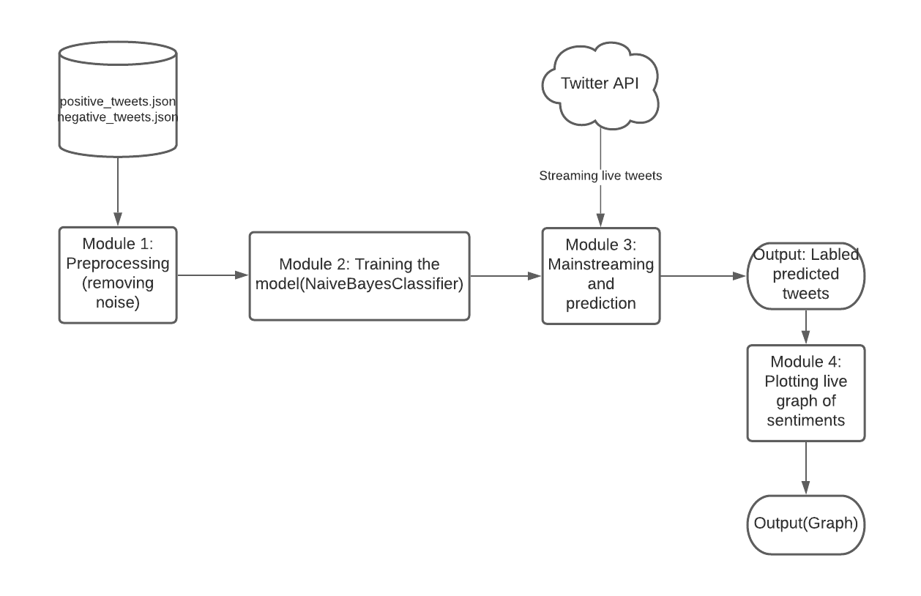
Block Diagram:

Slide 4
Details of the modules:
Module 1 - Preprocessing (Removal of Noise)
Module 2 - Training the model ( Naive Bayes Classification)
Module 3 - Main streaming tweets and prediction
Module 4 - Plotting Live graph of the sentiment

Slide 5
Module 1 - Preprocessing (Removal of Noise)
Input: Samples which are already classified into positive and negative.
Output: Normalized tokens that are free from noise.
Explanation:
In this module the tweets are tokenized and noise in the data such as hyperlinks, twitter handles in the replies, punctuations, special characters and stopwords are removed. Then the data is normalized using lemmatization.
The most basic form of analysis on textual data is to take out the word frequency. A single tweet is too small of an entity to find out the distribution of words, hence, the analysis of the frequency of words would be done on all positive tweets.

Slide 6
Module 2 -Training the model ( Naive Bayes Classification)
Input: Normalized tokens that are free from noise.
Output: The model that is trained with Naive Bayes Classification
Explanation:
In the data preparation step, we will prepare the data for sentiment analysis by converting tokens to the dictionary form and then split the data for training and testing purposes.
We attache a Positive or Negative label to each tweet. It then creates a dataset by joining the positive and negative tweets.By default, the data contains all positive tweets followed by all negative tweets in sequence. When training the model, you should provide a sample of your data that does not contain any bias. To avoid bias, we randomly arrange the data using the .shuffle() method of random.
Then, the code splits the shuffled data into a ratio of 70:30 for training and testing, respectively. Since the number of tweets is 10000, you can use the first 7000 tweets from the shuffled dataset for training the model and the final 3000 for testing the model.
Finally, we use the NaiveBayesClassifier class to build the model. Use the .train() method to train the model and the .accuracy() method to test the model on the testing data.

Slide 7
Module 3 - Main streaming tweets and prediction
Input: Live tweets steamed from twitter.
Output: Sentiment( positive or negative) of the live tweets.
Explanation:
By using tweepy library, we provide proper keys and tokens to get authentication from twitter account and we live stream tweets of a random topic from twitter.
Then this live streamed data( unseen data) is given as input the model to test the model. The predicted sentiments are stored in a list.

Slide 8
Module 4 - Plotting Live graph of the sentiment
Input: The predicted sentiments which are stored in a list.
Output: Live graphing of the sentiments of the tweets.
Explanation:
We use matplot library to plot the graph of the predicted sentiments.

Slide 9
MODULE 1:

Slide 10
INPUT:
The imported datasets from NLTK that contains the following datasets.
negative_tweets.json: 5000 tweets with negative sentiments
positive_tweets.json: 5000 tweets with positive sentiments
tweets.20150430-223406.json: 20000 tweets with no sentiments

Slide 11
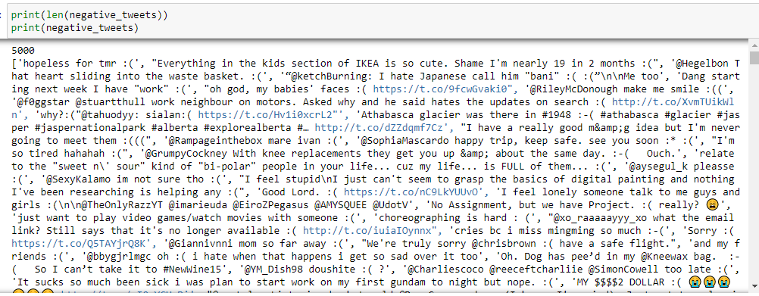
Input: negative_tweets.json

Slide 12
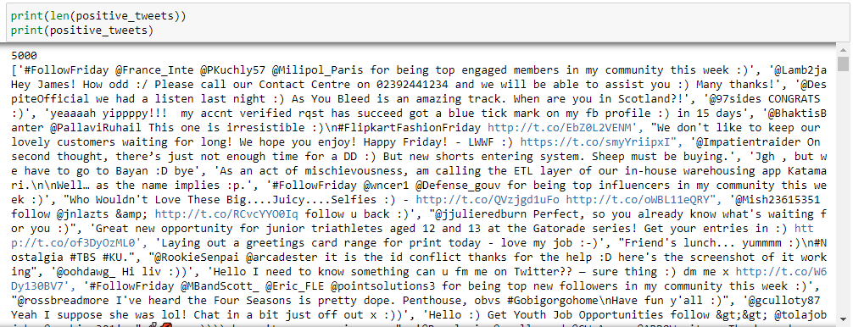
Input: positive_tweets.json

Slide 13
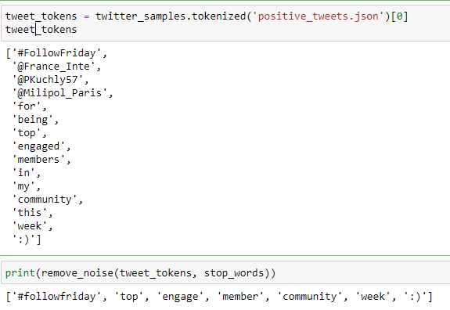
Input and output of sample tweets are attached:

Slide 14
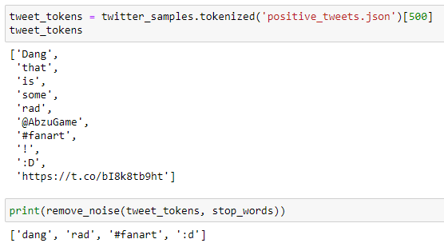
Input and output of sample tweets are attached:

Slide 15
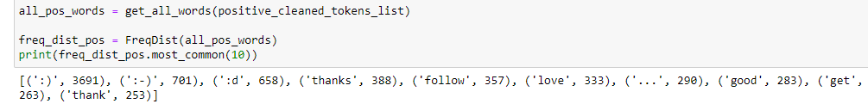
Final output is frequency distribution of tokens:

Slide 16
MODULE 2:

Slide 17
INPUT:
The preprocessed data is given as input:
negative_cleaned_tokens_list
positive_cleaned_tokens_list

Slide 18
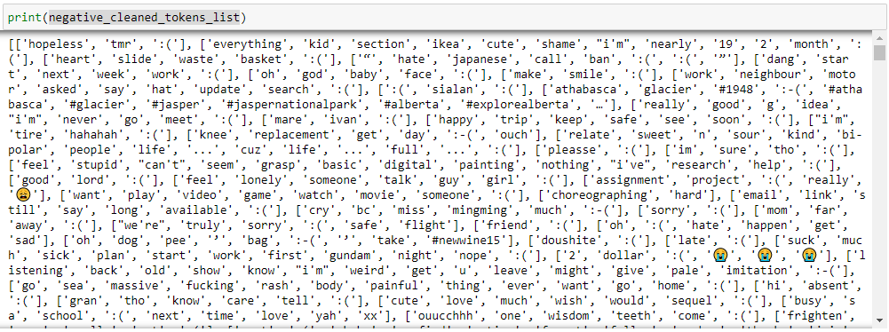
Input: negative_cleaned_tokens_list

Slide 19
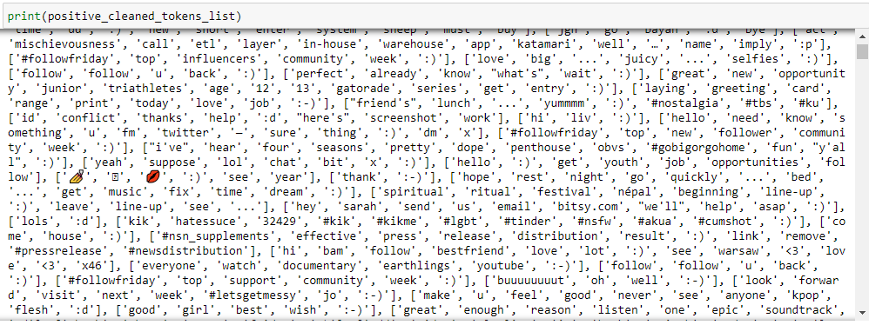
Input: positive_cleaned_tokens_list

Slide 20
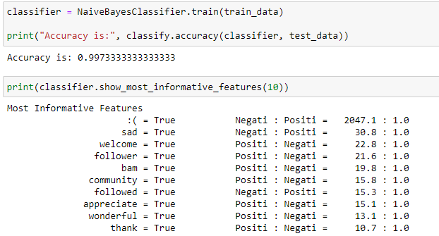
OUTPUT:

Slide 21
MODULE 3:

Slide 22
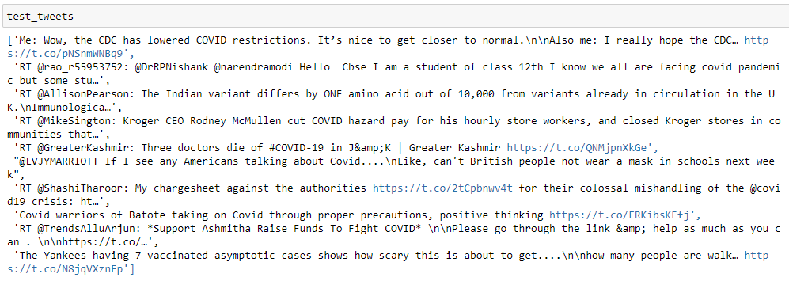
INPUT:

Slide 23
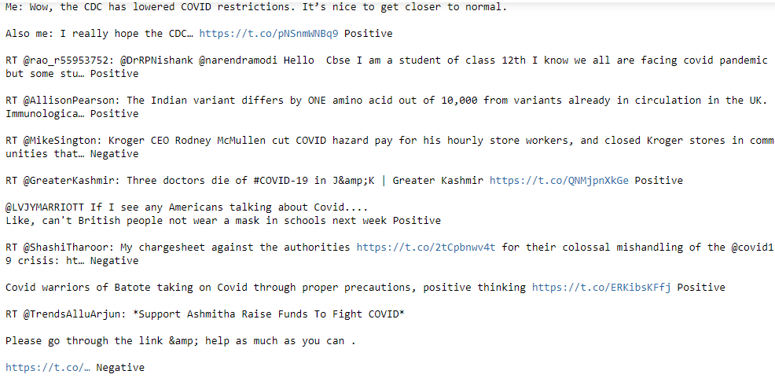
OUTPUT:

Slide 24
MODULE 4:

Slide 25
INPUT:

Slide 26
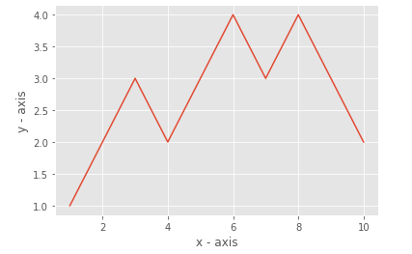
OUTPUT:

Slide 27
EVALUATION METRICS:

Slide 28
CONCLUSION:
A large amount of data that is generated today is unstructured, which requires processing to generate insights.
Some examples of unstructured data are news articles, posts on social media, and search history.
Therefore this model performs sentiment analysis to helps in analyzing the natural language and also helps in making sense out of it falls .
As a result the unstructured data can be easily structured with this model.

